Slide 1
Image Scan Holdings PLC AGM PRESENTATION
William Mawer - Chairman
21st February 2017

Slide 2
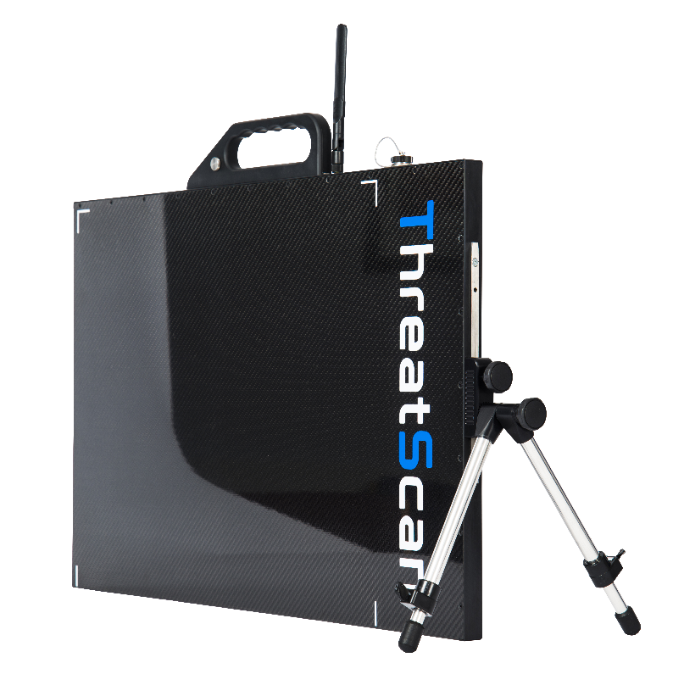
Introduction to Image Scan Holdings PLC
Developer and manufacturer of X-ray inspection systems focussed on two distinct segments
Portable X-ray for security and bomb detection
Industrial inspection for automotive emission control systems
Successful exporter (80% of sales overseas)
Expanding product range in growing markets
17 staff based in Loughborough, UK

Slide 3
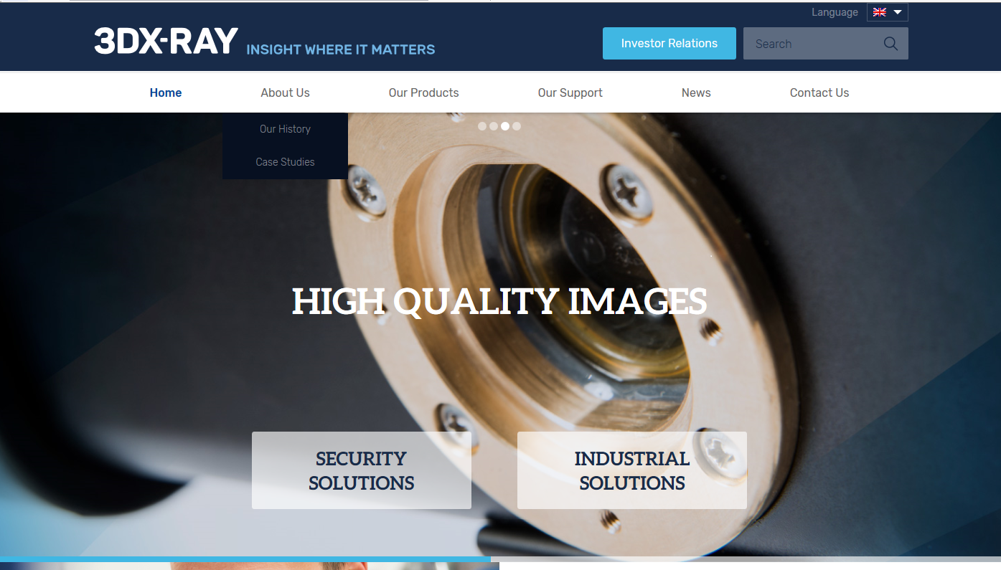
New public face for Image Scan and 3DX-Ray
New logo
New website
New promise
INSIGHT WHERE IT MATTERS

Slide 4
Recent Image Scan Milestones
Apr 2014: New board appointed
Sep 2014: Successful fund raise, allowed R and D spend to be doubled
Apr 2015: New portable X-ray launched at counter terror show
Jul 2015: Innovate UK grant awarded. New technology from Ibex Innovations
Aug 2015: First customer deliveries of new portable X-ray
Late 2015: Multiple orders for industrial X-ray systems
Jan 2016: Nuclear system out of warranty – moved to service contract
Jun 2016: Distribution agreement with Todd Research
Jun/Jul 2016: Large orders for new portable X-ray
Sep/Dec 2016: Volume deliveries

Slide 5
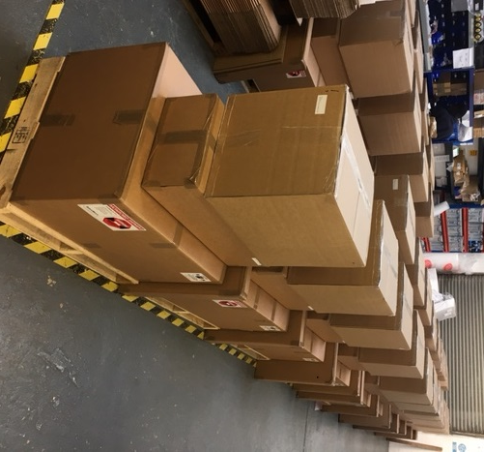
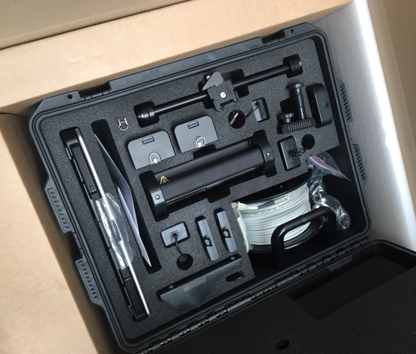
Performance improvement in FY 2016
 | 2016 | 2015 | 2014
Sales | £3.3m | £1.7m | £2.2m
GP% | 42% | 38% | 31%
Overheads | £1.4m | £1.3m | £1.2m
Pre tax trading profit (loss) | £105k | (£640k) | (£524k)
Cash | £1.0m | £469k | £948k
Recognised 75% of large order from Asia
Also Q4 deliveries to Europe, Middle East and North Africa
Growth in Industrial sales
Production and supply chain improvements
50+ portable X-ray systems in y/e order book

Slide 6
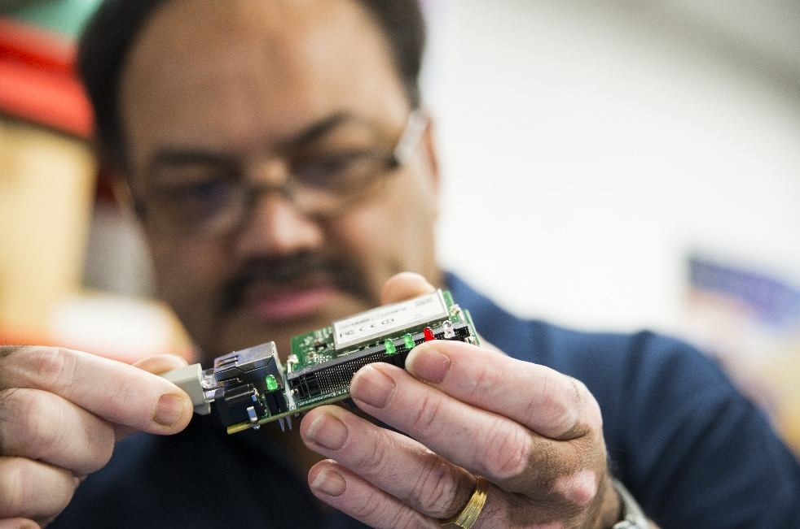
Other aspects of 2016 performance
Total order intake: £4.3m
Year end order book: £1.7m
Including over 50 portable X-ray systems
Increased total R and D spend 30% to £475k
Self funded
Customer funded
Grant funded
Improved stock control
Supply chain management
Key suppliers identified
Long term agreements in place
Flexible manufacturing

Slide 7
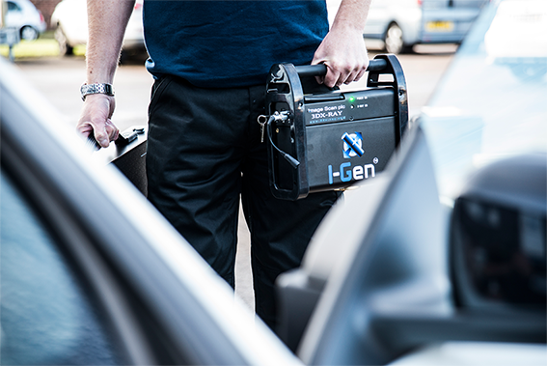
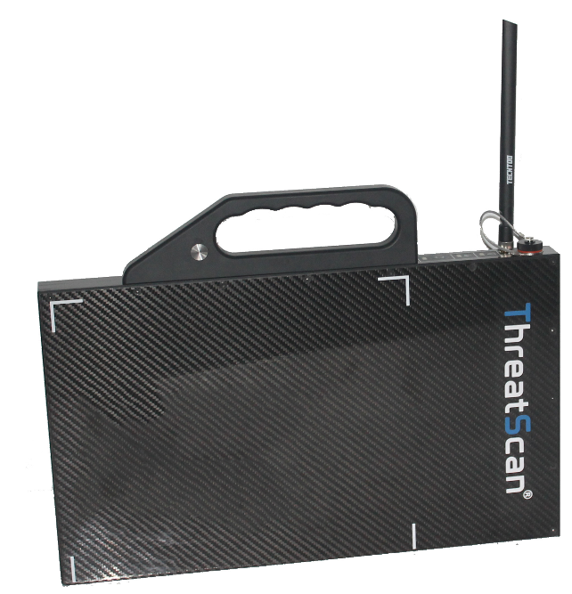
Post year end update
Strong first quarter trading
Large Asian order delivered ahead of schedule
New orders received maintain order book above £1m
New compact detector panel developed
Precision Linescan Detector moving towards launch in Q2
New industrial contracts

Slide 8
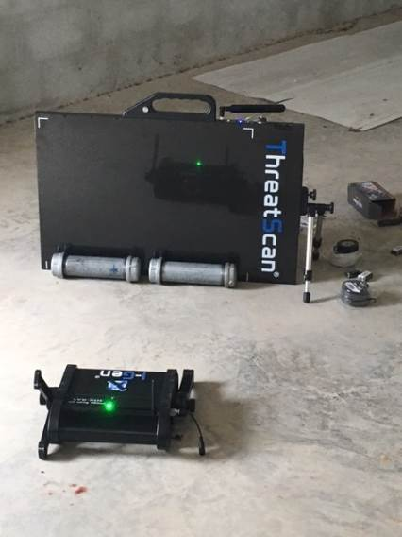
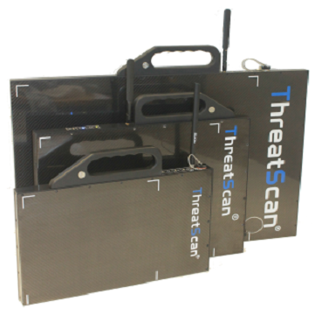
Focus on security
Won new customers in Europe, Asia and Middle East
First high volume sales of new system
Successful trials at international bomb disposal events in Thailand & USA
Declining sales of legacy checkpoint X-ray systems
First sales of Todd Research MailScan systems
Working prototype of Precision Linescan Detector
ThreatScan®-LS1 system on trial at global EOD event

Slide 9
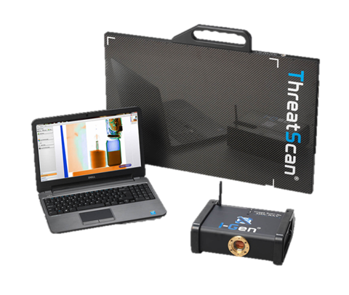
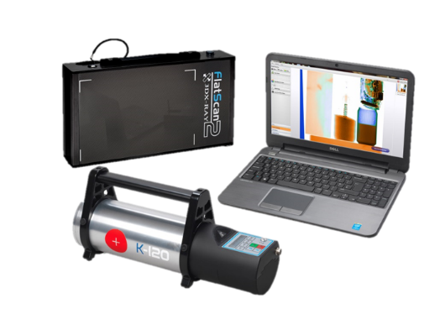
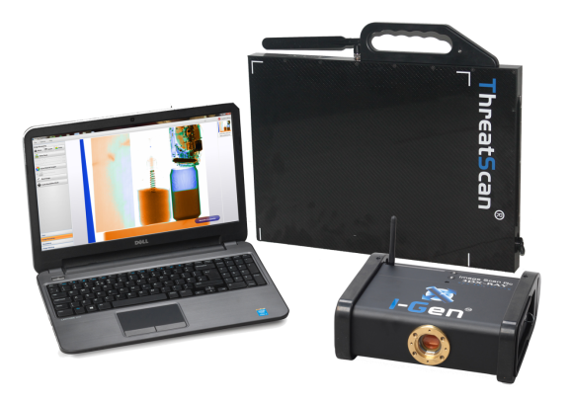
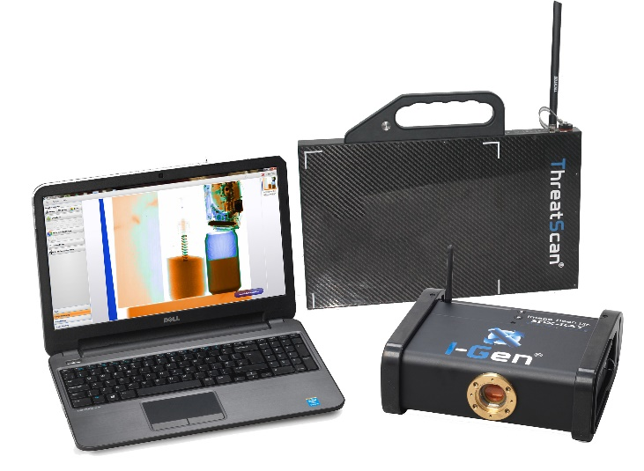
Focus on Security – expanded product range
MID RANGE
ThreatScan-LS1/I-Gen
ENTRY LEVEL
HIGH END
ThreatScan-PLD/I-Gen
FlatScan-Lite/K-120
Volume sales
ThreatScan-LS3/I-Gen
Sales building
Launch mid 2017
Launch April 2017

Slide 10
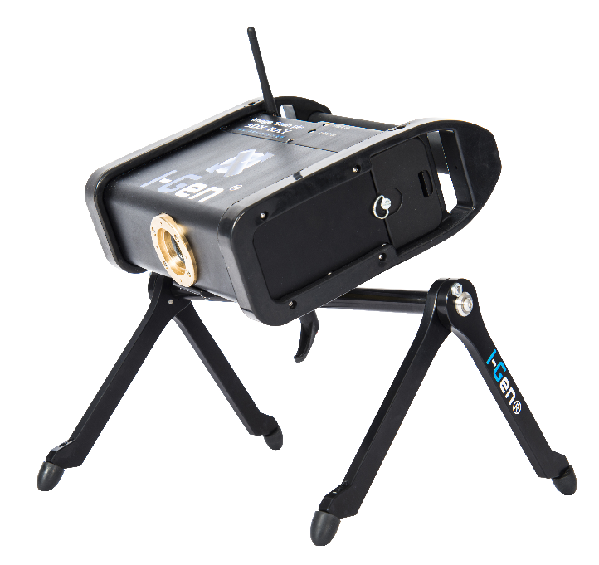
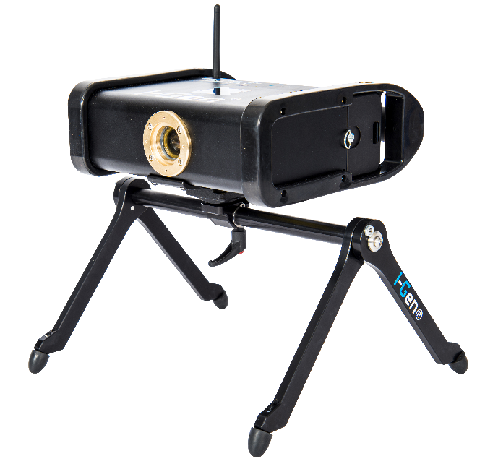
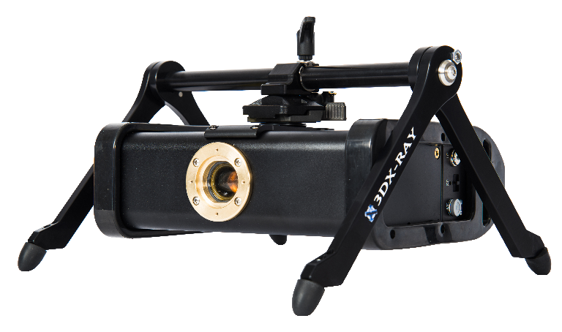
Focus on Security – accessories
New range of portable X-ray accessories
New stands, radiation protection, portability
New computers and communications options
Improved deployment flexibility
Differentiation vs competition
Adds value to orders
Example: flexible new generator stand

Slide 11
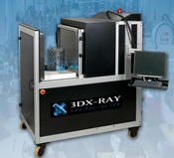
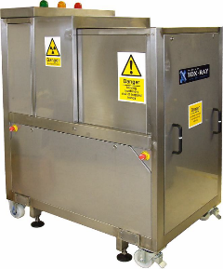
Focus on industrial
Now focussed on a single high growth niche improving manufacturing processes for automotive emission control systems
We inspect catalytic converters and diesel particular filters
Off-line X-Ray
Used to develop manufacturing methods and test at low volumes
In-line X-Ray
Used to carry out in-line production quality checks
Units sold, margin and support revenue all increased during FY2017
Customer funded development for new techniques, system integration and software functionality
Developing new IP for inspection of large diesel filters

Slide 12
Image Scan – longer term view
Overall growth approach
Long term aim: to build a substantial technology company
Growth in ISH market cap makes acquisitions achievable
Very experienced team with many acquisitions in last 10 years
Organic Growth
Scale
Share price improvement
Acquisition
?
12

Slide 13
Summary
An excellent year, built on solid growth in core markets
Strong order book and cash point to good H1- FY16/17
Strong product pipeline and new customers point to future organic growth
Potential for acquisition growth in relevant sectors
An ambitious management team with relevant experience
13

Slide 14
QUESTIONS?

